Slide 1
Loan Deafault Prediction
Machine Learning Project
Umar Farooque
14-09-2022

Slide 2
Agenda
Data Science Lifecycle​
Project Overview​
Data
Analysis
Modeling
Model Evaluation
Recommendations

Slide 3
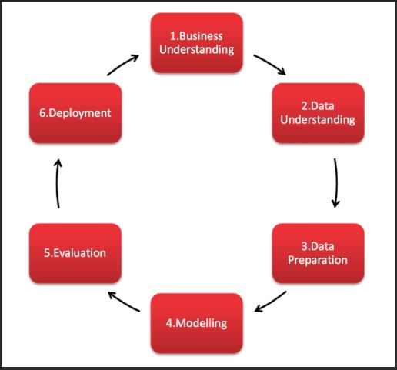
Data Science Lifecycle
CRISP - DM
Cross Industry Standard Process for Data Mining
It is a process model that naturally describes the data science life cycle. It helps us Plan, Organize and Implement our data science project. Here in this project we have tried our best to follow Crisp - dm process at every step.

Slide 4
Project Overview
Business Problem: Manual Home Loan Application approval is a slow and hectic process.
Business Objective: To automate the home loan approval process using credit worthiness of customers.
Hypothesis: We can build a Machine Learning model based on the available data of the customers i.e(credit worthiness etc.) which can predict weather or not a customer will default the loan.

Slide 5
Process Overview / Solution
Understanding Dataset : Importing dataset(train/test), defining target feature.
Exploratory Data Analysis : Insights from data using features correlation and visualization.
Data Pre-processing : Dealing with null values, feature encoding & preparing train / test data for model fitting .
Model Building : Applying ML algorithms and improving performance using best suitable parameters .
Cross Validating Model: Testing robustness of model for unseen data.

Slide 6
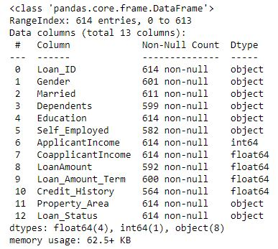
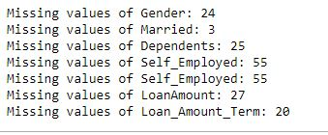
Dataset Description
Total Features : 13 (Including target feature)
Categorical : 8
Unique : 1
Continuous Numerical : 4
Target feature : Loan_Status (Y/N)

Slide 7
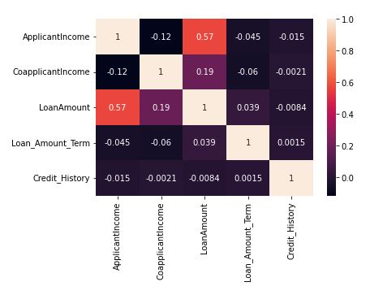
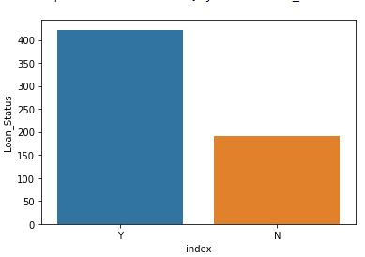
Exploratory Data Analysis

Slide 8
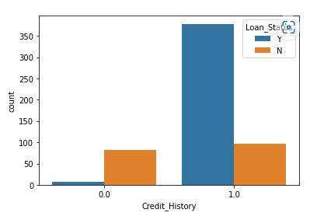
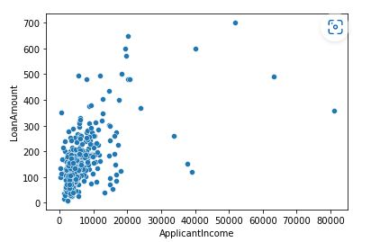
Applicant with Credit_History has more chances of loan_status yes.
Applicant income is highly correlated with Loan Amount.

Slide 9
Data Preprocessing
For Bespoke ML sklearn
Segregating relevant features from dataset for model building.
Handling missing values of features. Using mean(), median() & mode() gave better results than bfill(), ffill() methods .
Encoding of Categorical features done using Dummy variables .
Splitting dataset for training model . Split ratio (train : test) -> (80 : 20)
Scaling the features , Standardization method.
Now that our dataset is scaled, encoded & free from missing values, it’s ready for fitting model.

Slide 10
Model Building
Algorithm | Accuracy_Score | Precision | Recall
Logistic Regression | 79% | 76% | 81%
K-Nearest Neighbour | 73.9% | 92.5% | 74%
Decision Tree | 70% | 75% | 74%
Random Forest | 77.23% | 75% | 79%
Adaptive Boosting | 74% | 75% | 79%

Slide 11
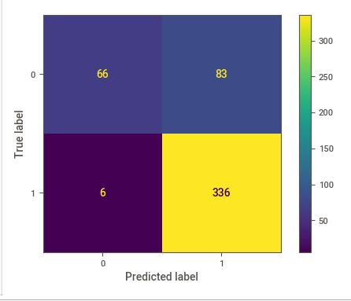
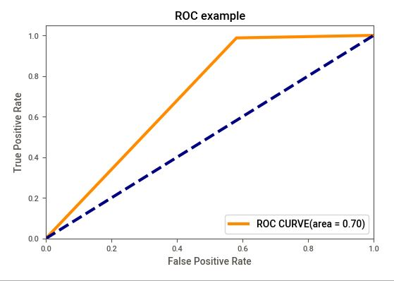
Model Evaluation
Logistic Regression to be performing better than other algorithms.
Hyper - parameter tuning (C : 1.0 , penalty : ‘l2’ ) accuracy : 79%
Mean Cross validation Accuracy : 81.27% , ROC area : 70% better

Slide 12
Recommendations
Applicants with Credit History are defaulting more so need to be careful with this feature.
Most male applicants & candidates with no dependents are having loan status as Yes/default.
Our model has a good Cross Validation score i.e performs well on unseen data making it a robust model.
But we can fit model and check performance with various algorithms like Boosting Techniques, ANN.

